Slide 1
MongoDB - Create Database
MongoDB use DATABASE_NAME is used to create database. The command will create a new database if it doesn't exist, otherwise it will return the existing database.
Syntax
use DATABASE_NAME
To display database, you need to insert at least one document into it.
In MongoDB default database is test. If you didn't create any database, then collections will be stored in test database.
Commands
> use employeedb
> db
> db.employee.insert({"name":"ram"})
> db.employee.insert({"name":"ram"})

Slide 2
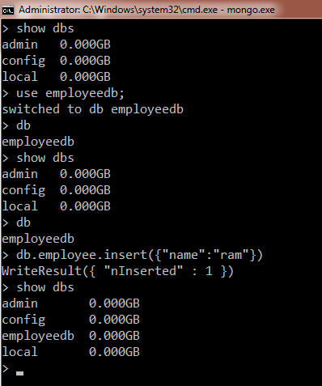
MongoDB - Create Database

